Slide 1



Copilot for Microsoft 365
Partner opportunities

Slide 2
Package Copilot for Microsoft 365services
Drive innovation and business transformation for customers around the world with Copilot for Microsoft 365 offers. Tap into the millions of Microsoft customers and bring generative AI to the productivity suite they know and trust, setting them up for success with pre-sales and post-sales support alongside best-of-breed protection and education. Take innovation to a new level and amplify the capabilities of Copilot with the power of plugins and Microsoft Graph.
AI + Copilot for Microsoft 365 Advisory
Copilot for Microsoft 365 Readiness
Copilot for Microsoft 365 Deployment
Adoption & Change Management
Copilot for Microsoft 365 Extensibility
Lead business transformation conversations with Copilot
Provide guidance for the responsible use of AI
Identify personas and scenarios that would deliver the most value if reimagined with AI
Assess licensing and technical readiness
Assess customer data protection and governance
Showcase the benefits of Copilot
Identify high-value scenarios
Close readiness gaps
Build a business case
Plan customer success with Microsoft account teams
Evaluate Microsoft 365 tenant usage and configure security and compliance
Launch pilot
Drive change management programs
Establish employee communication channels
Measure business impact
Conduct employee training
Continuously support and optimize
Conduct line-of-business app assessments
Extend value with Copilot plugins and connections
Connect data to Microsoft Graph and Dataverse
Deliver integration, customization, and configuration services
Partner practice development resources https://aka.ms/AIFutureOfWorkPartner

Slide 3
lead the AI transformation is ours
The opportunity to
190M
addressable seats

Slide 4
Target customers
Customer Profile | Early Access Program (EAP) Customers | Microsoft 365 E3/E5 Customers | On-Premises Customers
Customer Needs | Expand Microsoft 365 Seats Identify high-value scenarios and start planning for pilot launch | New to Copilot for Microsoft 365 Looking to adopt generative AI quickly | Not on Microsoft 365 E3/E5 licenses Looking to move to an Enterprise suite and bring SharePoint, OneDrive, etc. to the cloud
Sales Play | Conduct envisioning sessions, readiness assessments, and art of the possible workshops Configure Copilot for Microsoft 365 for high-impact scenarios Support deployment of pilot Drive adoption across the organization and set up a champ community for 2 – 3 scenarios Continue to improve, train, and support | Lead with the value proposition of Copilot for Microsoft 365 Embed generative AI into the productivity apps your customer uses every day to unleash creativity, unlock productivity, and uplevel skills Drive adoption of Microsoft 365 (Copilot uses information available to users within MS Graph to retrieve their business data) Leverage deployment and adoption resources | Lead with secure productivity and Copilot for Microsoft 365 Copilot inherits your customer’s security, compliance, and privacy policies in Microsoft 365 Set up a strong Zero Trust foundation, streamline endpoint management, and elevate productivity Microsoft 365 is foundational to being AI-ready Leverage the ME3 offers and promos

Slide 5
Business opportunity with Copilot for Microsoft 365 for Partners

Slide 6

Help SMBs on their AI journey every step of the way
Unlock Copilot for Microsoft 365
Foundational Productivity
Drive change management and user skilling on AI
Copilot users in Microsoft 365 Business Standard/Business Premium
Opportunity
Upsell to Business Premium and provide managed services
Microsoft Cloud solution
Acquire SMB with Business Premium to get AI ready
On-premise or compete solution users
Notes:
And unlock the Copilot for Microsoft 365 opportunity for SMBs when it becomes available.

Slide 7

Copilot Offers Additional Revenue and Profitability Opportunities
Teams Phone
Deployment
Microsoft Copilot for M365
Deployment Services Copilot for M365
Teams meeting room
Deployment
Microsoft Copilot
Endpoint MDR/SOC
NIST/CIS - Security Frameworks Standarization
Data Protection, Restriction, and Labeling
The partner services opportunity is 2-3x of the Business Premium license price
Business Premium Managed Services
Risk Assessment / Security Assessment
Save data to OneDrive
Get Ready with Services for AI
Onboarding services (email, endpoint, identity, remote access, etc.)
IProductivity Implementation
M365 Fundamentals
Device Lifecycle Management
Support
AI Readiness Assessment
Microsoft 365
Business Premium
Standard Services
Copilot for M365
Notes:
Desde el punto de vista de la rentabilidad de los socios, Business Premium también abre la puerta a la prestación de servicios gestionados a los clientes.
Hemos descubierto que los clientes están dispuestos a pagar por algo más que el coste de la licencia y, de hecho, los clientes de las pymes buscan socios que les ayuden con su experiencia en seguridad. Cuando un socio ofrece una solución integral que incluye seguridad, los clientes están dispuestos a pagar hasta 116 dólares por usuario al mes.

Slide 8
Copilot managed services for Microsoft 365 example
Deployment of Microsoft Copilot for M365
Using the Copilot Deployment Checklist to Deploy Copilot for M365
Data Protection & Labeling
DLP Policies, SharePoint Restrictions, Data Retention Policies, and Automatic Data Classification
Data Structuring
CSP Services
Implementation of productivity
M365 Fundamentals
Use AI Assessment to Evaluate the Copilot AI Customer Journey
Implement core productivity with Business Standard and Business Premium and bring customer data to OneDrive
AI Readiness Assessment
Copilot for M365
Copilot for Microsoft 365 License
M365 Lighthouse Multi-Tenant Management

Slide 9
Reach new & existing SMBs excited about Copilot for Microsoft 365
On-premises customers ready for cloud migration
Customers looking to consolidate apps and software to one solution
Customers on
competitor solutions
Partner can:
Microsoft Graph
Bring new customers into the
Microsoft Cloud
Messages
Meetings
Chats
Migrate on-premises servers
File
sharing
User
Calendar
Remediate legacy file shares. Use SharePoint/ OneDrive for file storage and sharing
Notes:
Your partner opportunity with new and existing SMB customers excited about Copilot for Microsoft 365 includes:
Migrating on-prem customers to the Microsoft Cloud including helping customers migrate on-prem servers and file share.
Assisting customers in consolidating apps and software to the cloud and leveraging SharePoint/OneDrive for file storage and sharing which connects customer tenant data to the Microsoft Graph.
Winning customers from competing solutions who are excited about AI.

Slide 10

Prepare customer environments for a better Copilot for Microsoft 365 experience
  Implement good content management practices to prepare organizational data for Copilot.
  Review data governance policies, protect sensitive organizational data, and prevent content oversharing. Microsoft 365 allows you to:
Messages
Meetings
Chats
    Apply a retention or deletion policy for Copilot interactions
    Data loss prevention policies to protect sensitive data, generated by Copilot and saved in M365 locations, from exfiltration
    Exclude sensitive files that users have no view permission from being processed by Copilot for said users
File
sharing
User
Calendar
Business Premium value
semantic index
Microsoft Graph
Notes:
Copilot inherits your organization’s existing Microsoft 365 security, compliance, and privacy policies. Your data is logically isolated and protected within your Microsoft 365 tenant, and always within your control. So by design, Copilot for Microsoft 365 respects user-specific and group permissions to any content or information it retrieves, and only generates responses based on information that users explicitly have permission to access. Help SMBs assess their data and security policies to prepare customer environments for a better Copilot for Microsoft 365 experience and protect sensitive org data.
Microsoft 365 allows you to classify Teams to ensure the right people are in the right conversations.
Business Premium specifically, includes important capabilities such as data loss prevention policies to help customers protect sensitive data, generated by Copilot and saved in M365 locations, from exfiltration
Doing these things will help ensure the Semantic Index for Copilot for Microsoft 365 is reasoning over the set of business context and content that will surface the most relevant and actionable information from within the organization to the end user and prevent things like content oversharing and accidental leakage.

Slide 11

Partner opportunity to reach new and existing customers with Copilot
  Enable Intune policies to ensure only managed and secured devices and browsers are accessing AI tools
  Drive change management through end-user awareness & readiness
  Train users on Gen AI prompt readiness to get the most out of Copilot and Copilot for Microsoft 365
  Upsell to Microsoft 365 to prepare for Copilot for M365
Notes:
Help SMBs get the most out of Copilot - Combine Copilot with Microsoft Edge to enable a more secure AI-powered web-browsing experience.
Enable Intune policies so only Edge can access company resources and AI tools
Drive change management through end-user awareness & readiness
Train users on Gen AI prompt readiness to get the most out of Copilot and Copilot for Microsoft 365

Slide 12
Readiness assessment
Section break – Option 1

Slide 13

Copilot for Microsoft 365 ready
Yes?
Lead with Copilot
Address technical readiness gap
Copilot uses information available to users within the
MS Graph. To retrieve their business data, users will need
to deploy and adopt Microsoft 365 first.
Deploy
Copilot
Customer on
Microsoft 365 E3/ME5
/Biz Premium
Copilot ready
Enable Copilot Center of Excellence
Leverage deployment and adoption resources
No?
Lead with Secure Productivity + Copilot
Deploy Microsoft 365 E3/BP
Drive usage & pitch Copilot
Microsoft 365 is foundational to being AI ready. Although Copilot will be a difference license, customers will need to be on Microsoft 365 E3/E5 as a base license.
Leverage the Microsoft 365 E3 offers and promos
Notes:
Deployed in your Azure subscription, secured by you, and tied to your datasets and applications.

Slide 14

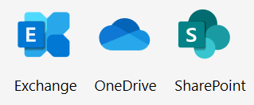

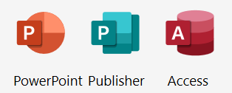





Get your SMB customers AI ready
For up to 300 seats
Microsoft 365 Business Standard
Microsoft 365 Business Premium
Cloud services
Cloud services
Desktop apps
Desktop apps
$12.50 per user/month
Comprehensive security
Intune
Azure Information protection
Azure AD Premium
Windows Virtual Desktop
Microsoft Defender
$22 per user/month
Microsoft 365 Business Standard, Business Premium, E3 and E5 are prerequisites for Copilot for Microsoft 365.
Microsoft Copilot with commercial data protection, is available at no additional cost to Business Standard/Premium customers.
Price is subject to change based on subscription term, currency and region.
Not all features/product logos shown.
Notes:
Get customers on to Microsoft 365 and onto the cloud by directing new customers to either Business Stand or Business Premium and upselling existing Business Standard users to Business Premium. For SMB customers with up to 300 licenses, Business Standard/Business Premium are prerequisites for Copilot for Microsoft 365 and enables customers to connect their data to the Microsoft Graph.

Slide 15


Security and Compliance controls for Copilot for Microsoft 365
Essential security controls
Comprehensive security controls
Copilot +
M365 Business Standard
Copilot +
Microsoft 365 Business Premium
Multi-factor Authentication and security defaults when accessing M365 to use Copilot
Basic security controls for mobile devices accessing M365 resources
Basic content search for Copilot prompts and interactions
Audit logs and retention or deletion policies for Copilot interactions
Prohibit copilot from including sensitive data in responses for users that have no extract permissions
Exclude sensitive files from being processed by Copilot for users that have no view permission
Everything in M365 Business Standard, plus:
Conditional Access policies based on identity, device, location, & network to access M365 resources when using copilot
Manage the access and use of M365 apps across devices that use Copilot
Manually label and protect Microsoft 365 content (files and emails only) used by Copilot and inherit and cite sensitivity labels in Copilot outputs
Protect sensitive M365 data generated by Copilot from exfiltration (files & emails only)
eDiscovery, case management and legal hold capabilities for Copilot prompts and interactions
Note: Not all features/products shown.

Slide 16

Get Ready for Copilot for Microsoft 365
Empower employees with secure, AI-powered tools
Organize sensitive business data
Standardize on M365
Start using Gen AI with Copilot
Migrate Data to Cloud
Optimize your data management and security practices
Immediate Customer Value
Microsoft Copilot with commercial data protection for users signed in with Entra ID at no additional cost
Migrate/upgrade to cloud – Exchange Online, Teams, SharePoint online, Microsoft 365 apps
Protect business data from external threats with Identity & Endpoint
Train users on using AI in the workplace for faster ROI realization
Create and build your graph for a more relevant experience with Copilot for Microsoft 365
Manage data retention and labeling for safer AI use internally
Long Term
Value
Inoculate your customer base against competitor solutions
User adoption & change management
Partner Opportunity
Acquire new customers
Data Migration Services
Upsell to M365 Business Premium
Security Managed Services
Notes:
Supercharge your Cloud Solution Provider (CSP) business by preparing your SMB customers to leverage Copilot. Here’s a look at the actions to take across customer scenarios:
Drive change management and user skilling on AI with Entra ID customers with Microsoft Copilot by getting them using generative AI now with Copilot.
Acquire new customers (who are currently on-prem or using compete solutions) with Microsoft 365 Business Standard / Business Premium to get AI ready.
Upgrade existing customers to get their M365 ready for Microsoft 365 Copilot—here’s where you can provide managed services to help SMBs get AI ready.
On aka.ms/CSPGetAI, you will discover programs and investments we are making in FY24 to help drive your business – including go-to-market content, fresh assets, readiness content, and incentive programs.

Slide 17
AI + Copilot advisory
Section break – Option 1

Slide 18
Preparing for the era of AI
What are your organization's goals
for using AI?
What are your organization’s
pain points
that AI can address?
What are your organization's current capabilities in terms of AI?
Does your organization have a data strategy
in place?
Does your organization have the necessary infrastructure and resources
to support AI initiatives?

Slide 19
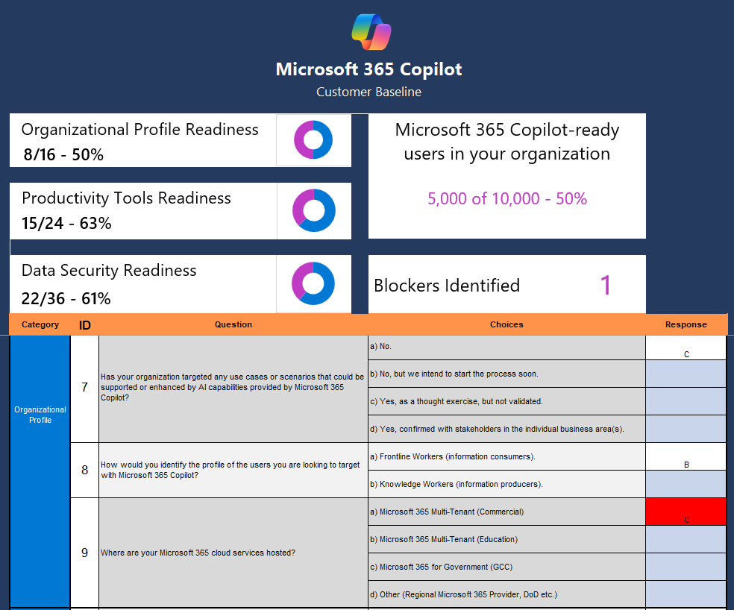
Copilot for Microsoft 365 Optimization Assessment
An excel-based tool that can be used by Microsoft field and partners to run a consultative engagement to determine a customer’s readiness to deploy Copilot and steps needed to optimize the experience
Questionnaire covers 4 categories: User readiness, Organizational readiness, Productivity tool readiness, and Data security readiness
Users that are ready for Copilot based on core criteria - sourced from the M365 AI Impact Dashboard
Summary of critical blockers and customer’s readiness in each category. Readiness gaps represent opportunities for further optimization of Copilot experience
Provides guidance for steps to be taken to address blockers and optimize
Options to address gaps in Data Security Readiness include:
Identify and address oversharing issues with SharePoint Advanced Management
Initiate Security Compliance trial to demonstrate Microsoft Purview’s data classification and permission management capabilities
Conduct Data Security engagement

Slide 20




Key responsibilities of container and content governance
Empower
employees
Identify
valuable content
Protect
assets
Ensure
accountability
Support self-service creation
Use life-cycle management
Require classification for containers
Scan with data loss prevention (DLP)
Limit reach
Enforce policy
Use conditional access
Use Information Rights Management (IRM)
Manage group/site ownership
Review external membership
Use IT services

Slide 21
Deploying Copilot
Notes:
1) Utilize the readiness materials
2) Discover the high value scenarios and build a ROI for your customers
3) Fortify your organization for the best experience
a. Modernize your environment
b. Secure your data

Slide 22
Unify a complex, disconnected IT ecosystem into a single secure foundation
Devices
Operating system
Security
Management
Collaboration
that meet specific
job requirements
that’s secure, easy to manage,
update, and use
that defends against cyberattacks across multiple platforms
that is built for a heterogenous device estate, including personal devices
that connects every employee
across all devices

Slide 23
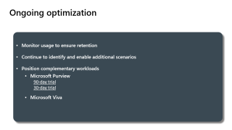
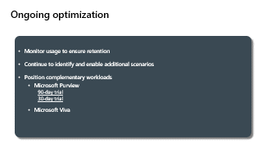
Ongoing optimization
Monitor usage to ensure retention
Continue to identify and enable additional scenarios
Position complementary workloads
  Microsoft Purview
    90-day trial
    30-day trial
  Microsoft Viva

Slide 24
Adoption & Change Management

Slide 25
Readiness & Adoption Planning
Utilize readiness materials and staffing from Microsoft and our Partner ecosystem to build skills and complete your Copilot implementation. Build for long term sustainability and growth of service use.
Copilot Implementation
Staff Adoption Team
Complete Technical Readiness
Implement Adoption Program
Executive & Business stakeholders
IT & technical staff
Adoption specialists, User experience staff
Microsoft & Partner support
Governance & information architecture strategy
Tenant readiness actions
License deployment & user onboarding
Ongoing service health reviews
End user and executive communications planning
Early adopter and adoption program onboarding
Ongoing community and end-user engagement
Feedback and success story sharing

Slide 26
Keys to adoption success
Research results below support suggested approach for building your adoption plan
Top reported activities for driving successful product adoption.*
1
Define a vision and identify how target product will be used
% of respondents that rated activity as having above average importance
Obtain proactive support from key roles to accelerate use of Copilot including senior leadership, legal, ITDM and key BDMs
2
3
Enable Champions & provide business relevant, snackable & on-demand training for end users
4
Raised awareness through launch event & omni-channel communications planning
*Results of a related Microsoft research study survey

Slide 27
Craft a User Experience Strategy
A user experience strategy will enable you to quantify the value received from adopting Copilot for Microsoft 365.
1
Identify target user personas
3
Define engagement touch points
5
Success measures and use cases
2
Quantify pain points and potential productivity gains
4
User feedback methods and issue resolution
Driving adoption is an ongoing user and stakeholder engagement process.
Your technology enablement team is central to the success of your project and your employees with your technology investments. Your user experience strategy gives them a vision and roadmap for success.

Slide 28
Copilot Extensibility
Section break – Option 1

Slide 29



Plugin types
Use existing integrations or build new ones to extend your organization’s AI-powered skills.
Teams
Message Extensions
Message extensions allow users to interact with a web service through buttons and forms in the Microsoft Teams, Outlook, and Microsoft 365 app clients.
Power Platform
Connectors
A proxy or a wrapper around an API that allows users to leverage a set of prebuilt actions and triggers to build their apps and workflows.
Open AI
Plugins
Open AI plugins connect ChatGPT to APIs, enabling it to perform actions like browsing and interacting with websites and games.
Existing Investments
New

Slide 30
Copilot for Microsoft 365 extensibility value
Trust
Copilot for Microsoft 365 extensibility enables you to expand your organization’s AI-powered productivity, capacity, and creativity.
Copilot for Microsoft 365 Extensibility
Extend
users’ skills.
Connect Copilot to the applications you work with plugins to streamline your everyday tasks and activities.
Expand
Organizational knowledge.
Ground Copilot in your organization’s content and data to create even deeper insights and connections.
Preserve
trust.
Copilot operates within your organization’s security and compliance boundaries and adheres to Microsoft’s responsible AI standards.
(Plugins)
User skills
Copilot for Microsoft 365
(App skills)
(Graph)
(Graph Connectors)
Organizational knowledge
(Semantic Index)
Notes:
Lean into value on X-axis.

Slide 31
Extend your users’ skills
Plugins enable users to interact directly with third-party app & services from inside Copilot.
Plugins
Keyword search and retrieve
Perform actions on behalf of user
Summarization & ideation via semantics and similarities around indexed content
Ranking and relevancy of content
Security, governance and compliance boundaries
Responsible AI guardrails
Available across Microsoft 365 | Copilot for Microsoft 365, Teams, Outlook, Office
Copilot for Microsoft 365 Extensibility
(Plugins)
User skills
Copilot for Microsoft 365
(App skills)
(Graph)
(Graph Connectors)
Organizational knowledge
(Semantic Index)

Slide 32
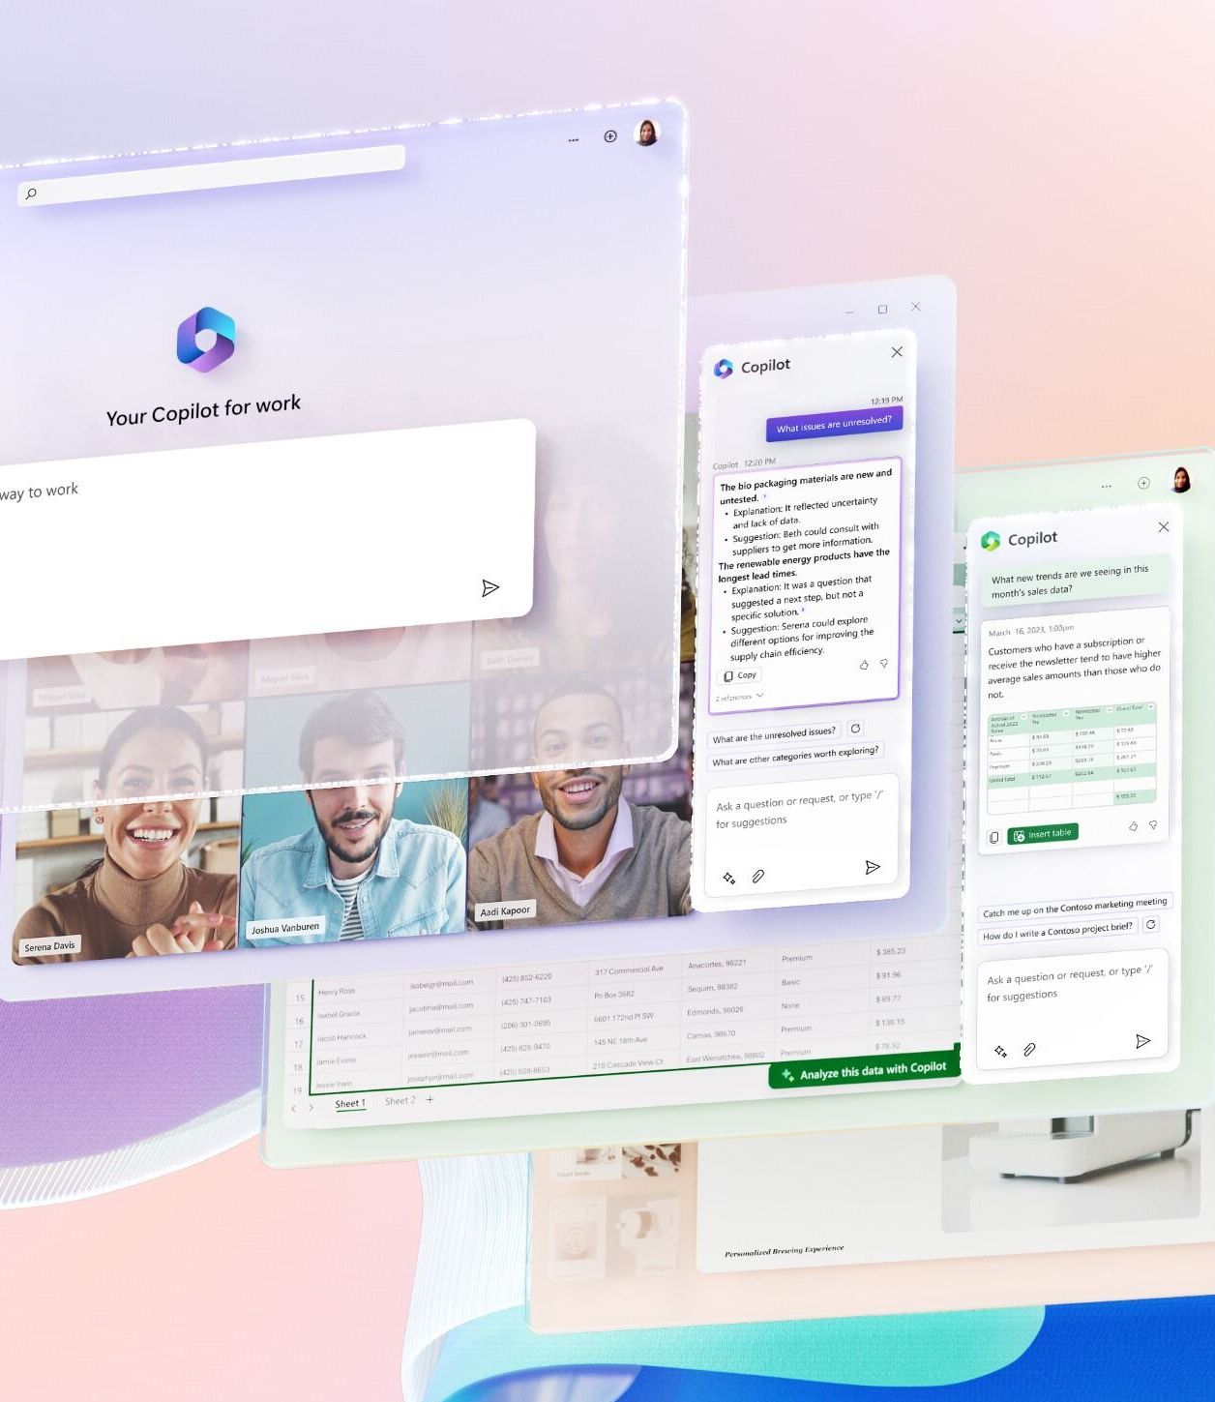
Resources
https://aka.ms/AIFutureOfWorkPartner

